Slide 1

Lecture 9: Unsupervised Learning
Intro to Data Science for Public Policy
Jeff Chen

Slide 2
Roadmap
Last thoughts on supervised learning
Unsupervised learning
K-Means
<break>
Hierarchical clustering
Intro to Data Science for Public Policy

Slide 3
<short-story/>
Last thoughts on classifiers

Slide 4
Checklist for structuring your project
1) Do each Y=1 and Y=0 have at least n = 100?
2) Does either Y=1 or Y=0 fall below 10% of the sample?
3) Is your sample drawn from a population on which you can generalize and score?
4) Does your sample represent what you think it represents?
Last thoughts on supervised learning

Slide 5
Checklist for structuring your project
1) Do each Y=1 and Y=0 have at least n = 100?
If not, get more data.
Last thoughts on supervised learning

Slide 6
Checklist for structuring your project
2) Does either Y=1 or Y=0 fall below 10% of the sample?
If not, consider upsampling the small proportion by bootstrapping or duplicating the imbalanced class until the two classes have equal proportions. Consequence is that accuracies will be misleading.
For example: If Y = 1 (n = 300) but Y = 0 (n = 10000), then consider bootstrapping Y = 1 by 33x.
Last thoughts on supervised learning

Slide 7
Checklist for structuring your project
2) Does either Y=1 or Y=0 fall below 10% of the sample?
Why? Because confusion matrices will likely be misleading due to the differences in proportions.
 | Pred: T | Pred: F
Actual: T | 0 | 300
Actual: F | 0 | 9700
Accuracy = 97% with a TPR = 0% is not accurate.
Last thoughts on supervised learning

Slide 8
Checklist for structuring your project
3) Is your sample drawn from a population on which you can generalize and score?
If your sample is a one time deal (e.g. a one time survey, a one time data release), make sure you’re comfortable with your intended use.
For example: Fire prediction algorithms should have a constant stream of data.
Last thoughts on supervised learning

Slide 9
Checklist for structuring your project
4) Does your sample represent what you think it represents?
Not all answers are in the data if the data does not have enough coverage.
State your hypotheses. What constitutes the H0 and H1? Does your data have enough coverage to prove H1?
What you hope is in the data
Data doesn’t cover all of the subpopulations you need.
Last thoughts on supervised learning

Slide 10
Roadmap
Last thoughts on classifiers
Unsupervised learning
K-Means
<break>
Hierarchical clustering
Intro to Data Science for Public Policy

Slide 11
What if you didn’t have labels in a dataset?
Unsupervised learning

Slide 12
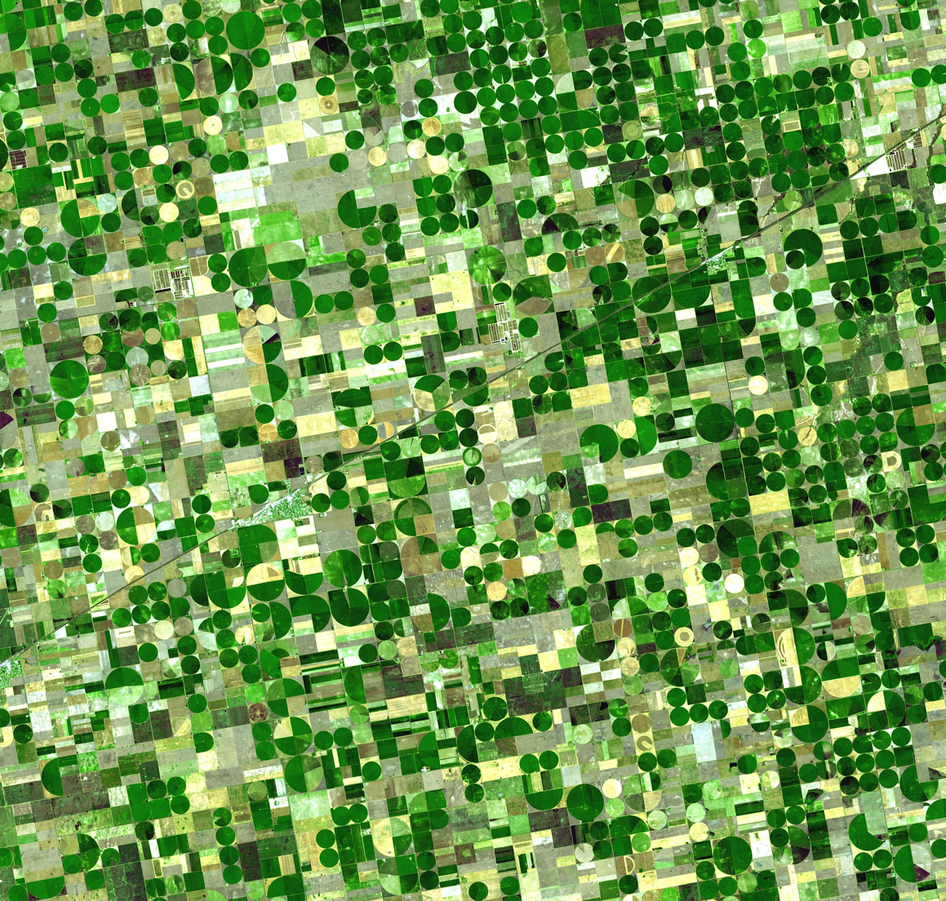
How much of the land is yielding growth?
K-means
Courtesy NASA

Slide 13
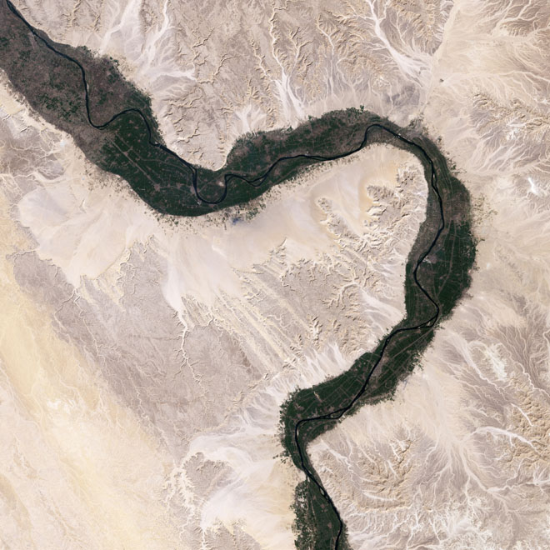
How can we extract the extent of the fertile areas of the Nile from a photograph?
K-means
Courtesy NASA

Slide 14
In the last election, which regions’ support swung for one party more than before?
K-means
Credit: BBC

Slide 15
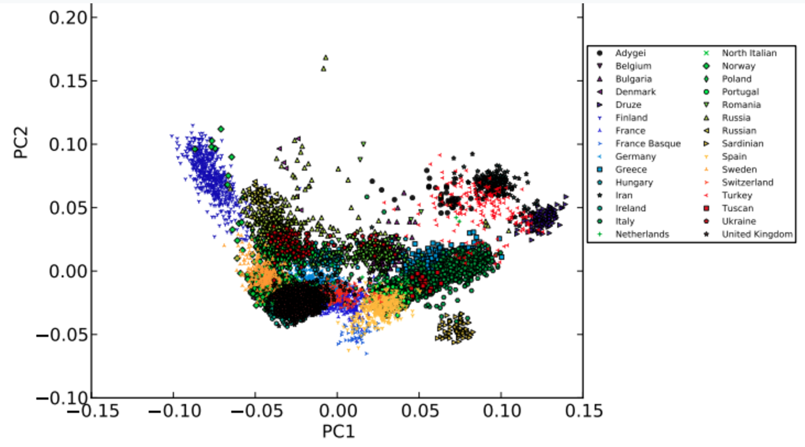
Which genes are correlated and can be expressed in lower dimensions?
K-means
Credit: 23andMe

Slide 16

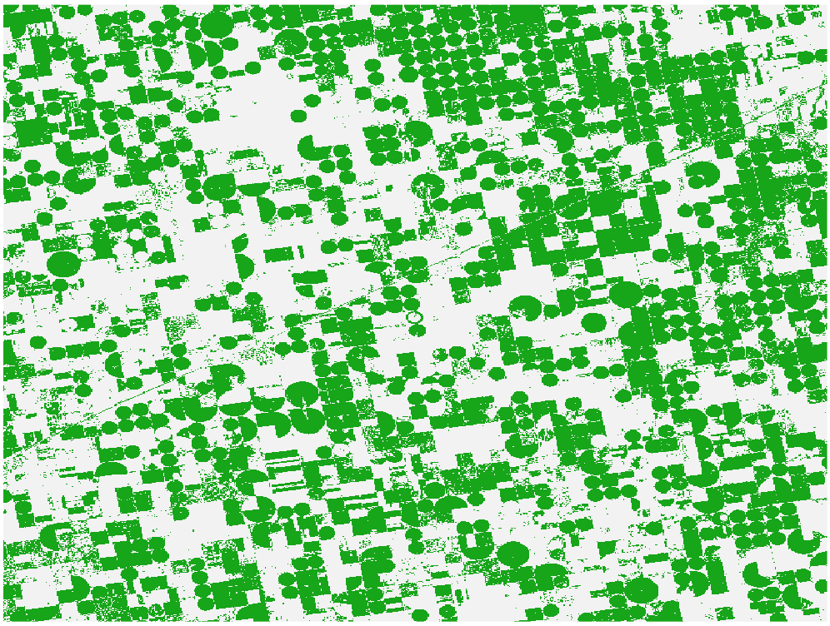
Answers: A lot or 46.7% of the image.
K-means

Slide 17
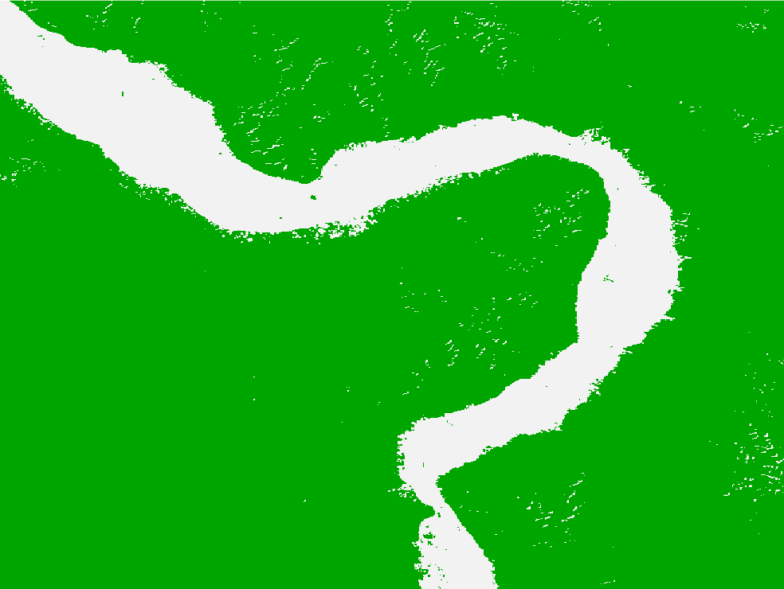
woot! →
K-means

Slide 18
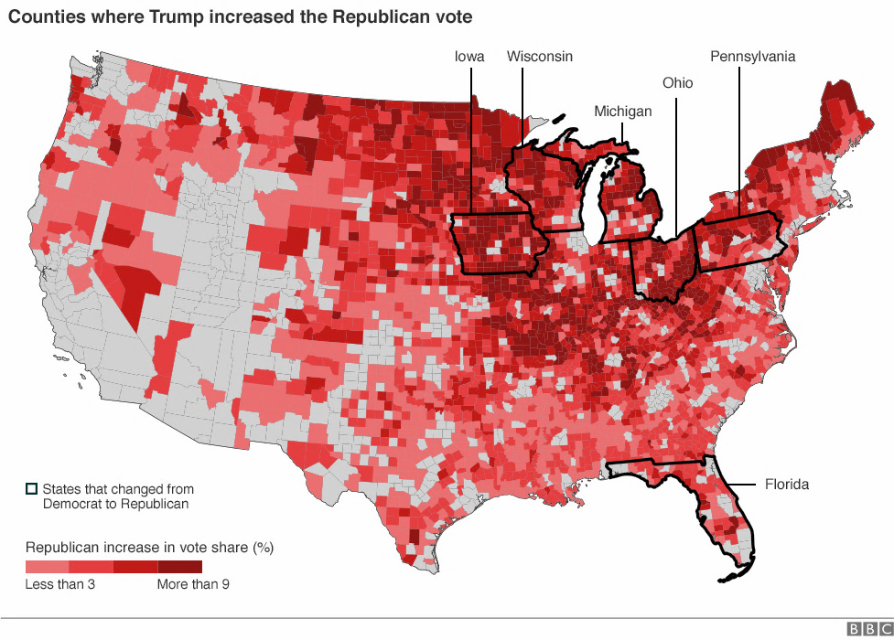
Which regions’ support swung for one party more than before?
(Note that the pattern is not bound by states)
K-means
Credit: BBC

Slide 19
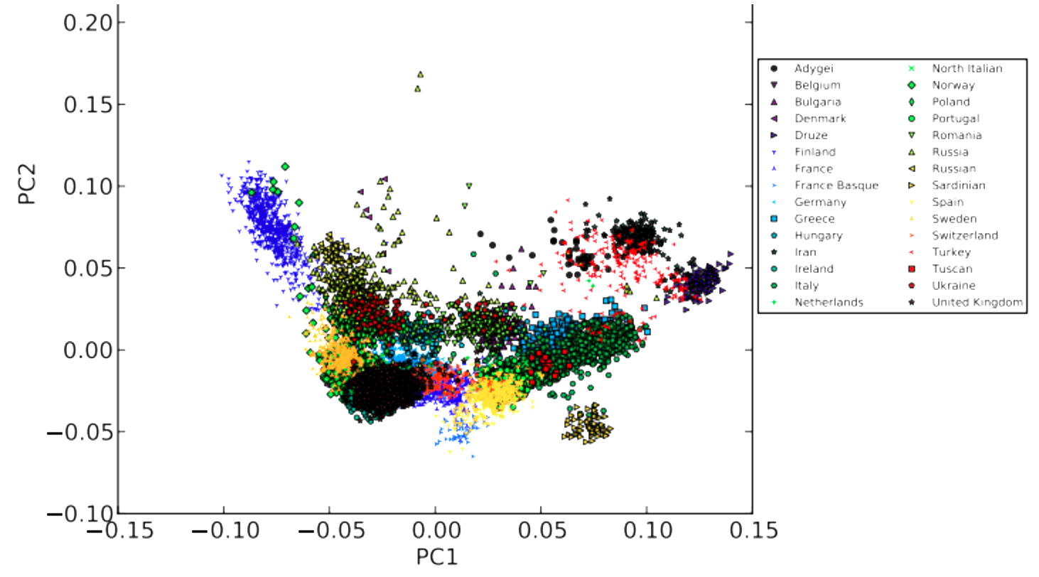
Depends. But for some ancestries, it can be as few as two variables
K-means
Credit: 23andMe

Slide 20
Supervised Learning
Goal: Learn and predict known phenomena
Data: Targets (labels), Input features
Eval: Common measures (e.g. ROC, F1, TPR)
Complexity: Statistical techniques tend to be complex
y = f(x)
Unsupervised Learning

Slide 21
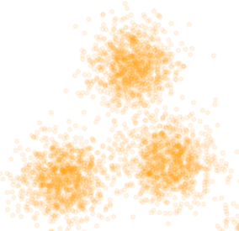
Unsupervised Learning
Goal: Find new patterns via clustering and latent features
Data: Only input features
Eval: Many evaluation measures or techniques, but none that are standard
Complexity: Statistical techniques tend to be simple and iterative
Unsupervised Learning

Slide 22
Two general tasks in unsupervised learning
Clustering can answer:
Which points can be grouped together based on their attributes?
Two common types:
K-means
Hierarchical Clustering (Agglomerative)
Dimensionality reduction
Which features have similar information and can be packaged into fewer principal variables
Two common types:
Principal Component Analysis (PCA)
Latent Factor Analysis
Unsupervised Learning

Slide 23
Formulation of Clustering Problems
Assumption:
There is some set of clusters k < n that represent naturally occurring groups
Unsupervised Learning

Slide 24
Formulation of Clustering Problems
Distance:
Some measure of distance based on input features can be used to determine similarity.
d
2 * d
`
2.2 * d
1.7 * d
1.5 *d
Unsupervised Learning

Slide 25
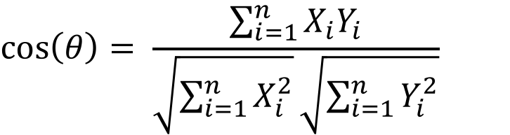
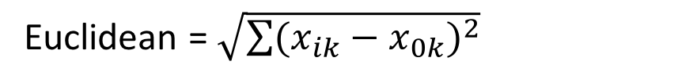

Formulation of Clustering Problems
Distance:
There are many types of distance. Selection depends on the type of problem and type of data.
Euclidean = $\sqrt{\sum{{(x_{ik}−x_{0k})}^{2}}}$
$$Manhattan=|x_{ik}−x_{jk}|$$
$$\cos\left(θ\right)= \frac{\sum_{i=1}^{n}{X_{i}Y_{i}}}{\sqrt{\sum_{i=1}^{n}{X_{i}^{2}}}\sqrt{\sum_{i=1}^{n}{Y_{i}^{2}}}}$$
Unsupervised Learning

Slide 26
Formulation of Clustering Problems
Stability:
Convergence may occur in a model run, but stability needs to be tested.
Unsupervised Learning

Slide 27
Roadmap
Last thoughts on classifiers
Unsupervised learning
K-Means
<break>
Hierarchical clustering
Intro to Data Science for Public Policy

Slide 28
Common uses of clustering
Marketing/Sales
Customer/audience segmentation – which characteristics of people tend to buy what? How do demand segments differ?
Genetics:
Clustering gene sequences and expressions
Image Pattern Detection:
Extracting features from images
Demography
Identifying demographic enclaves
Logistic Regression

Slide 29
What is k-means in 10 seconds?
K-means

Slide 30
In short
Given k-number of user-specified clusters, K-Means finds the local optima of a dataset such that each point is assigned to a cluster
Logistic Regression

Slide 31
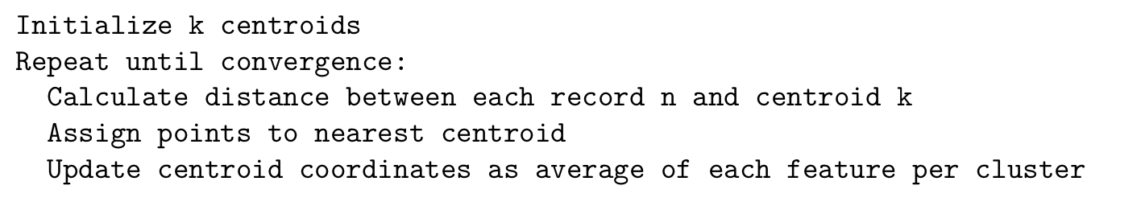
An algorithm that is as simple as it gets
K-means

Slide 32
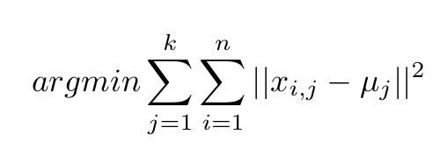
How it works
The goal is the minimize (arg min) the within-cluster variance (||x – u||^2), which is calculated for each point i and cluster j.
K-means

Slide 33
Initialization
The assignment of the point matters as k-means are deterministic algorithms. Types of initialization:
Forgy. Randomly select k points at once.
Random Partition. Randomly assign each point to k groups.
Hartigan Wong: A bit more complicated http://www.labri.fr/perso/bpinaud/userfiles/downloads/hartigan_1979_kmeans.pdf
Kmeans++. Places points one at a time at positions that are far away from one another to maximize chance that two points are not co-located.
K-means

Slide 34
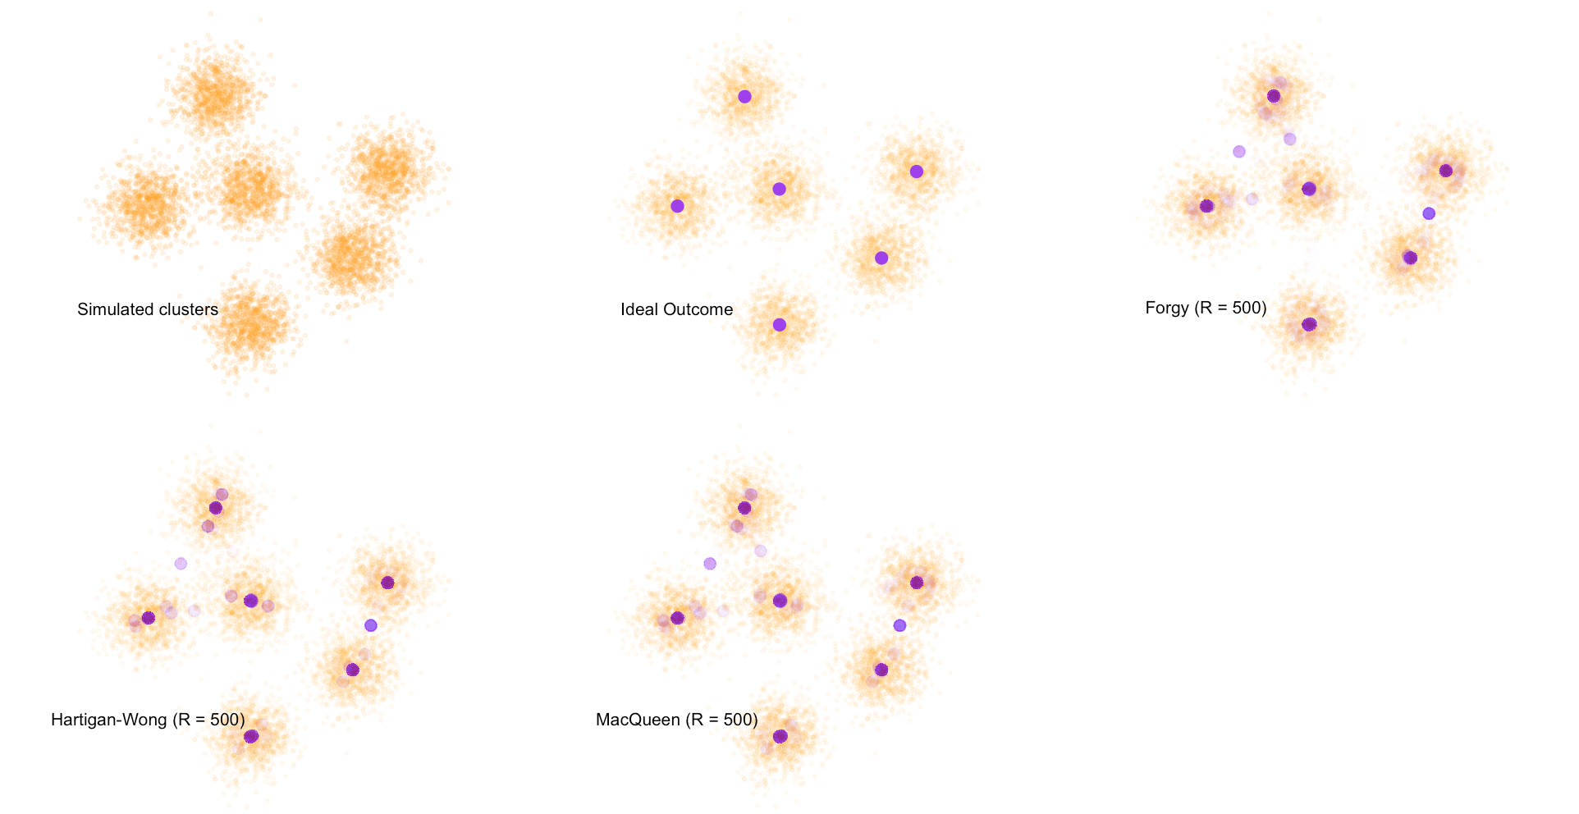
Convergence Differences (500 runs assuming k = 6)
While many runs converged on the right centroid coordinates, a notable amount does not.
K-Means

Slide 35
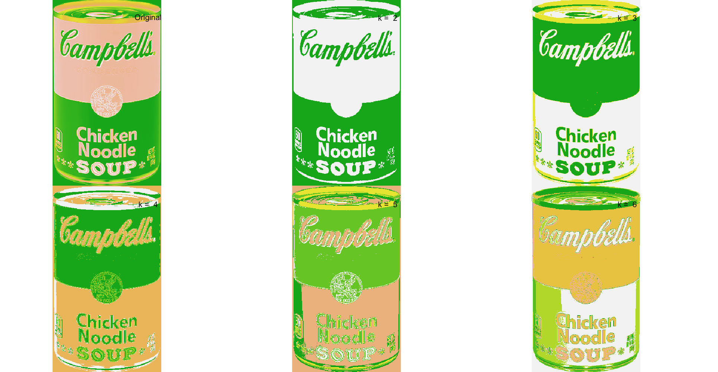
Instant Andy Warhol (k = 2:6)
K-Means

Slide 36
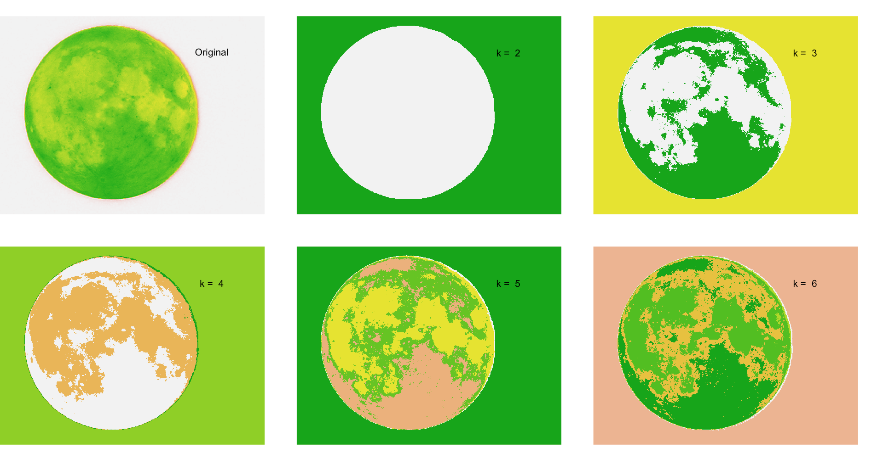
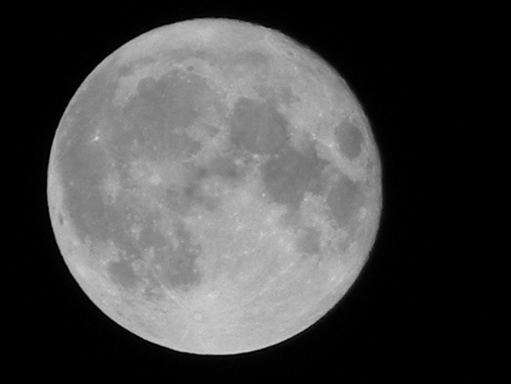
Cutting out the moon (k = 2:6)
K-Means

Slide 37
Segmenting Markets (k = 4)
Midwestern Company
< $52 million in revenue
<1000 employees
On-prem production
Exporter/Importer
Small Northeastern Company
<$10 milion
<100 employees
Product design
Outsource
Single Owner Operator
>$5 million and < $10 million
Legal services
Logistics focused
Large Businesses
> $1bn
Tech Industry
Non-Exporter
K-means

Slide 38
Assumptions
Can use any distance measure:
Euclidean distance: Continuous Real Numbers only.
Cosine Similarity: Binary and mixed values
All features need to be scaled (mean centered/ SD normalized) – all variables have equal weight.
K-means

Slide 39
Issues
Which k?
Lots of debate in the statistical circles as to how to determine k. Two typical methods include Elbows and Silhouette.
Elbow Method
Silhouette Method
WSS
k
Find the k where the WSS “bends”. WSS does not always bend…
Find k such that the silhouette is maximized (statistic that compares how similar it is to its own cluster vs. others)
K-means

Slide 40
<Code Time/>
K-means

Slide 41
Roadmap
Last thoughts on classifiers
Unsupervised learning
K-Means
<break>
Hierarchical clustering
Intro to Data Science for Public Policy

Slide 42
`
`
K-means relies on distance to centroids, but does not consider proximity to other similar points.
Hierarchical Clustering

Slide 43
`
`
Agglomerative clustering groups points together based on proximity to one another.
Hierarchical Clustering

Slide 44
Start
Middle
Finish
`
`
`
`
`
`
An algorithm that is a bit more computationally intensive and less arbitrary.
Calculate distance d between all points
To start, all points are set as their own clusters (singletons)
Until there is only one cluster:
Find the closest pair of clusters in terms of linkage distance
Merge into a single cluster
Recalculate distances from new cluster to all other clusters
Stop when all points are in one cluster
Hierarchical Clustering

Slide 45
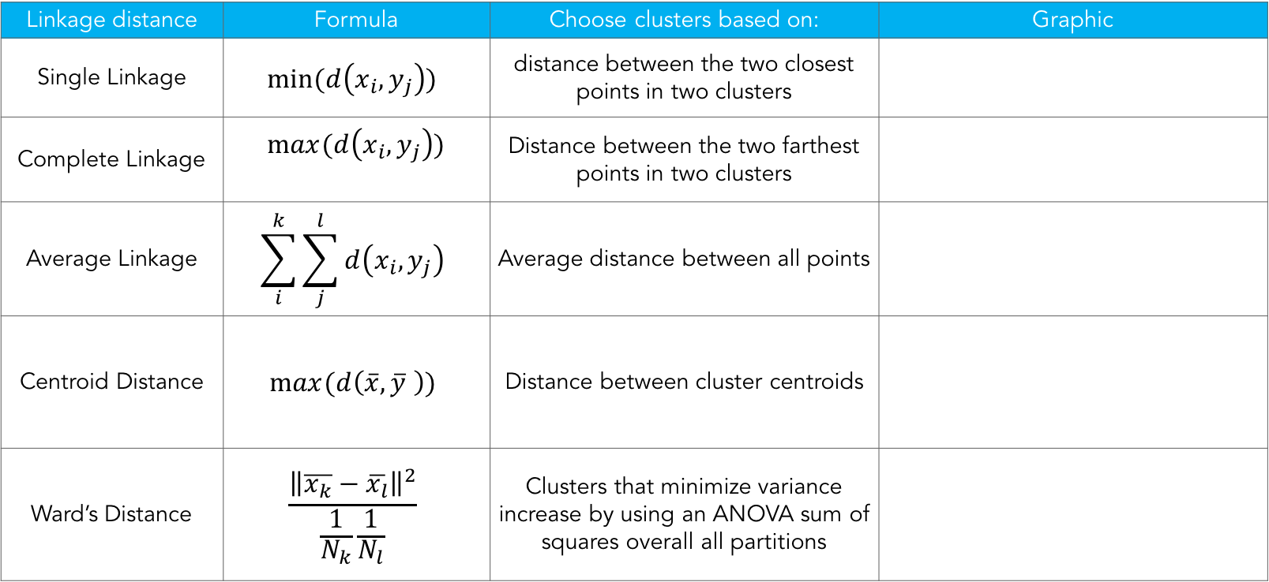
Many different ways of measuring distance
Linkage distance | Formula | Choose clusters based on: | Graphic
Single Linkage | $$min⁡(d\left(x_{i},y_{j}\right))$$ | distance between the two closest points in two clusters
Complete Linkage | $$max⁡(d\left(x_{i},y_{j}\right))$$ | Distance between the two farthest points in two clusters
Average Linkage | $$\sum_{i}^{k}{\sum_{j}^{l}{d\left(x_{i},y_{j}\right)}}$$ | Average distance between all points
Centroid Distance | $$max⁡(d\left(\overline{x},\overline{y} \right))$$ | Distance between cluster centroids
Ward’s Distance | $$\frac{{\left\|\overline{x_{k}}−\overline{x_{l}}\right\|}^{2}}{\frac{1}{N_{k}}\frac{1}{N_{l}}}$$ | Clusters that minimize variance increase by using an ANOVA sum of squares overall all partitions
Hierarchical Clustering

Slide 46
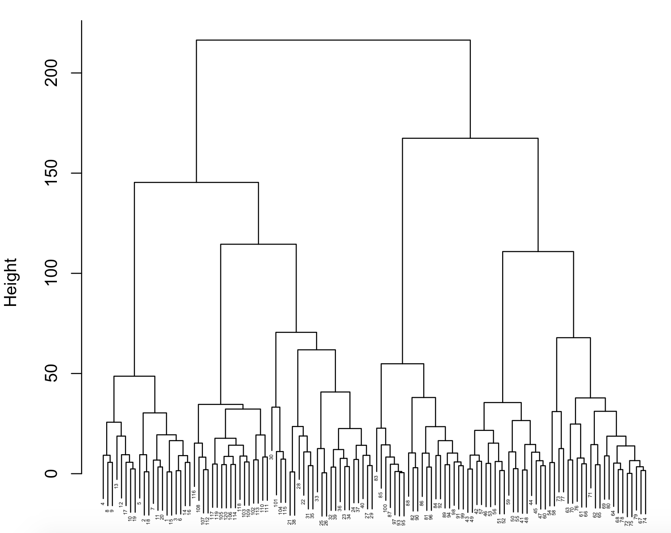
Dendrograms represent all the linkages.
Higher up the chart = greater distance between clusters.
Hierarchical Clustering

Slide 47
How do we choose clusters?
Hierarchical Clustering

Slide 48
<Code Time/>
Hierarchical Clustering

